Slide 1
Linear Algebra
线性代数
Zongbin Chen YMSC, Tsinghua University
陈宗彬 清华大学数学科学中心
Email: zbchen@tsinghua.edu.can

Slide 2

Quick review

Slide 3
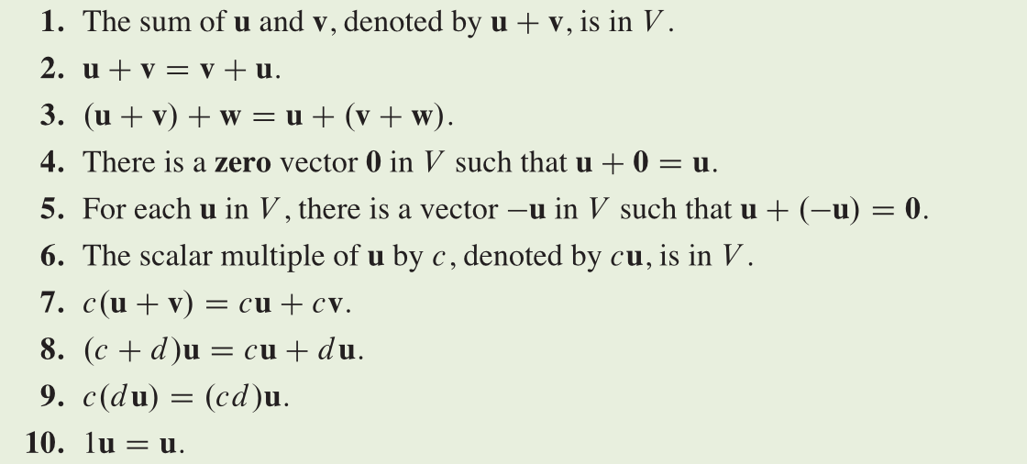



Definition: A vector space $V$ over $R$ is a set together with two operations:
Addition of vectors: $V×V→V,(v,w)↦v+w$
Scalar multiplication: $R×V→V,(c,v)↦cv.$
Satisfying the axioms:

Slide 4
Examples: The vector space of polynomials

Slide 5
Example: The vector space of real-valued functions on a set S.

Slide 6
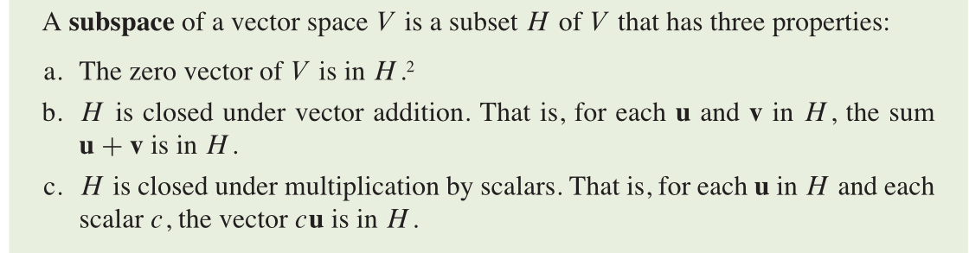
Remark: Similarly, we can define the complex vector space, by replacing the real numbers by complex numbers.
In the above examples, if we replace real coefficient polynomials by complex coefficient polynomials, or real-valued functions by complex-valued functions, we get corresponding complex vector spaces.
Similarly, we can define the concept of sub vector space.

Slide 7
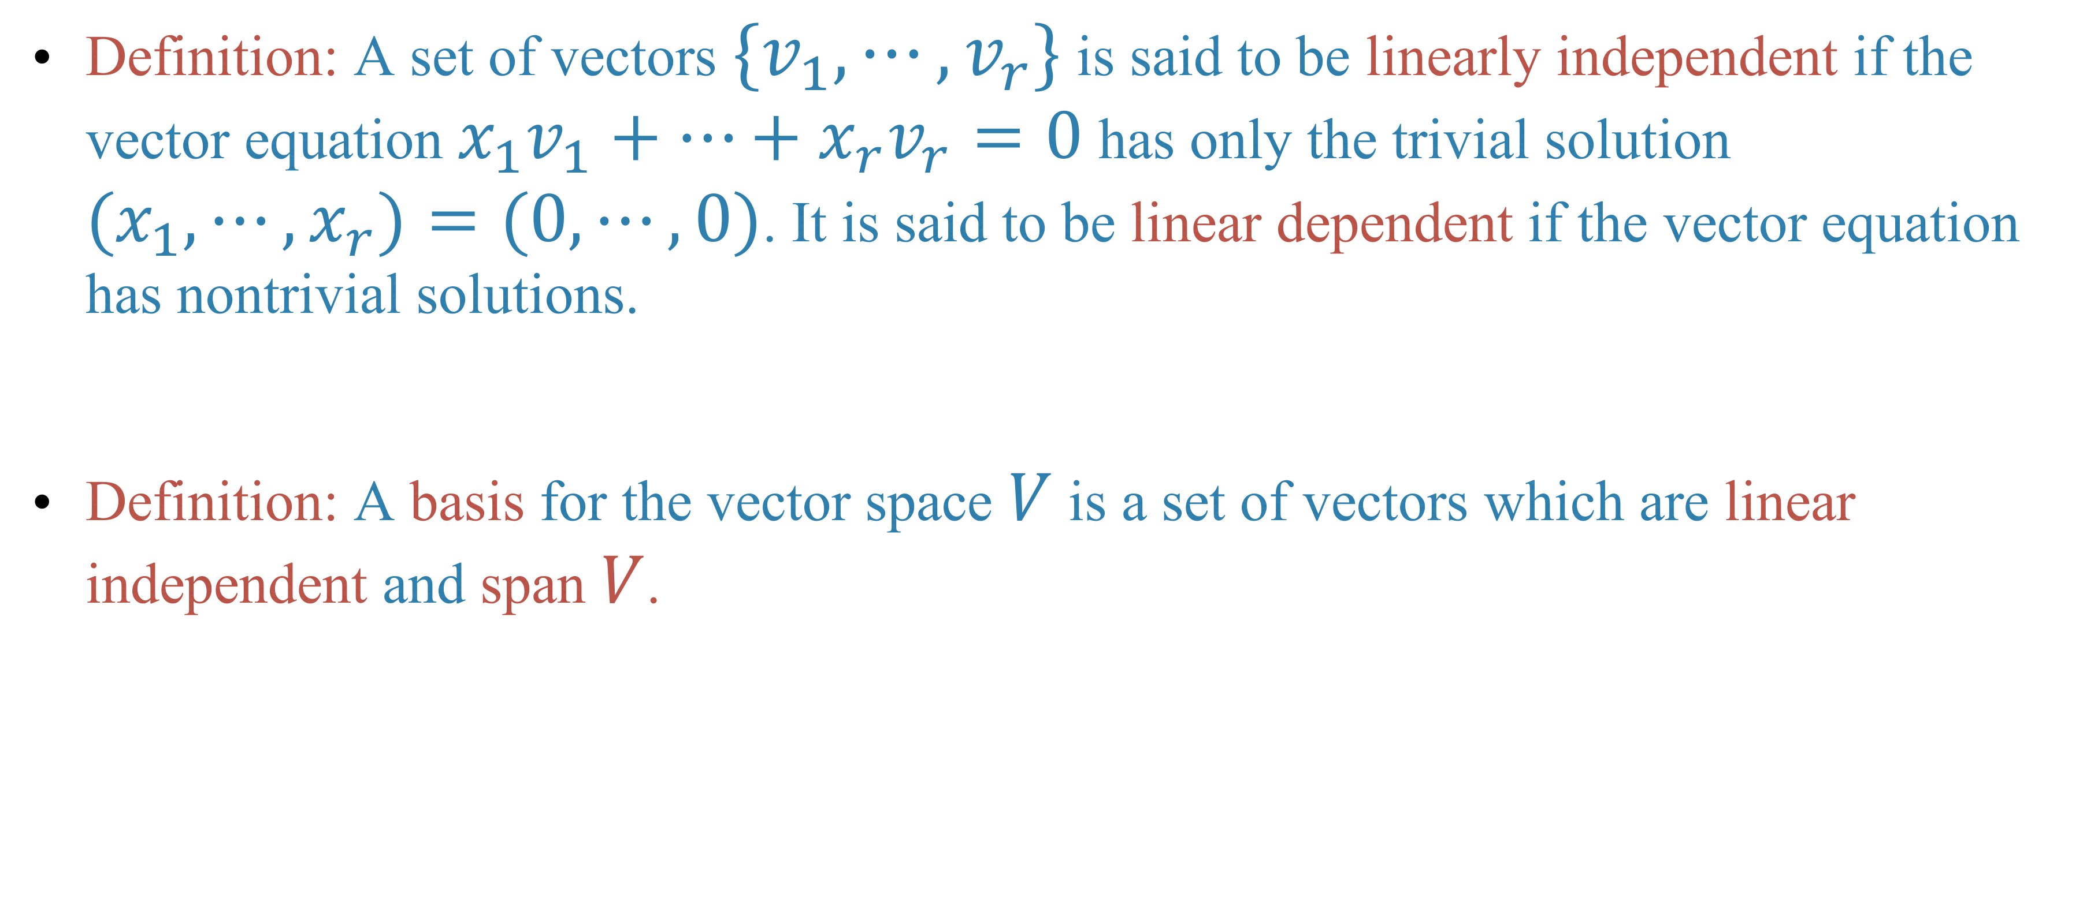
Linear independence, bases and dimension
Definition: A set of vectors $\{v_{1},⋯,v_{r}\}$ is said to be linearly independent if the vector equation $x_{1}v_{1}+⋯+x_{r}v_{r}=0$ has only the trivial solution $(x_{1},⋯,x_{r})=(0,⋯,0)$. It is said to be linear dependent if the vector equation has nontrivial solutions.
Definition: A basis for the vector space $V$ is a set of vectors which are linear independent and span $V$.

Slide 8
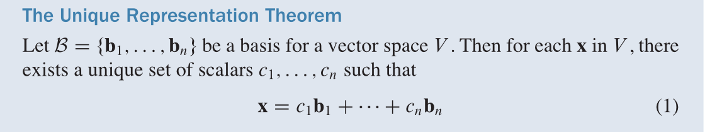
Theorem

Slide 9
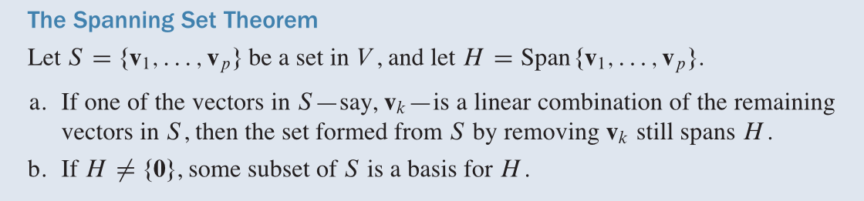

Definition: A vector space $V$ is said to be finite dimensional, if there exists finitely many vectors $v_{1},⋯,v_{r}∈V$ such that $V=Span\{v_{1},⋯,v_{r}\}$.
Theorem
Corollary: A finite dimensional vector space has at least a basis.

Slide 10
The dimension of a vector space
Theorem

Slide 12
Theorem

Slide 13
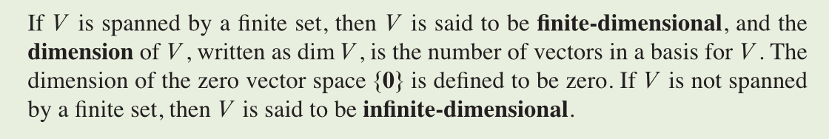
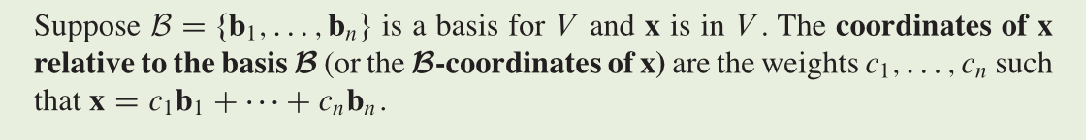
The number of vectors in a basis of a vector space is then an invariant of the vector space. We formalize it in the definition:
Definition

Slide 14
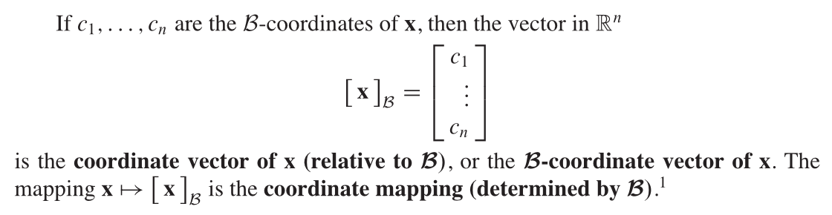

Slide 15

Theorem: A vector space of dimension $n$ over $R$ is isomorphic to $R^{n}$.

Slide 16
Example

Slide 17
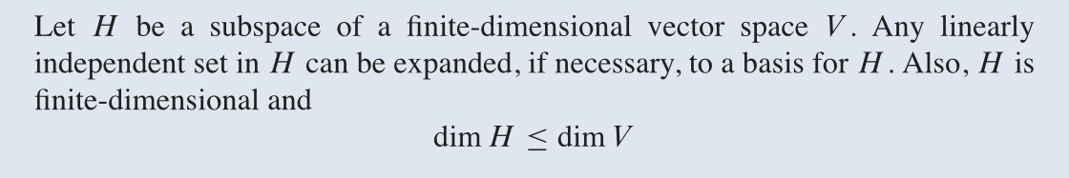
Sub space of a finite dimensional space
Theorem

Slide 20
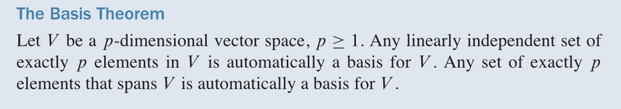
Theorem

Slide 21
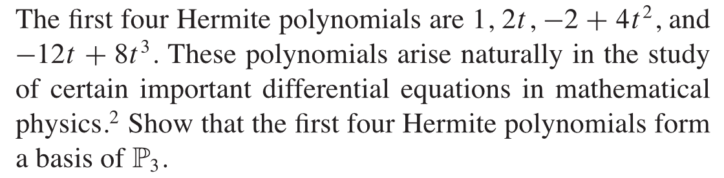
Example

Slide 23
Example

Slide 24
Homework
Lay-Lay-McDonald, chapter 4, 4.5 exercise, question 22, 28, 29, 30.

Slide 25
Next time
Lay-Lay-McDonald, 1.8-1.9.

